Slide 1
Java
Thread
Md. Shafqat Talukder Rakin
Lecturer, Department of CSE,
United International University
Email id : shafqat@cse.uiu.ac.bd
Acknowledged: Rifat Shahriyar Sir

Slide 2
Multitasking
Multitasking allows several activities to occur concurrently on the computer
Levels of multitasking:
Process‐based multitasking
Allows programs (processes) to run concurrently
Thread‐base multitasking (multithreading)
Allows parts of the same process (threads) to run concurrently

Slide 3
Advantages of Threading
Concurrency: Threading enables simultaneous execution of multiple tasks, improving overall program efficiency and responsiveness.
Resource Utilization: Threads make efficient use of CPU resources by allowing other tasks to run while some are waiting, maximizing CPU utilization.
Parallelism: Threading facilitates parallel processing, allowing for tasks to be divided and executed concurrently, leading to faster execution times.
Optimized Computations: Threading accelerates complex computations by utilizing available CPU resources for faster execution.

Slide 4
Main Thread
When a Java program starts up, one thread begins running immediately
This is called the main thread of the program
It is the thread from which the child threads will be spawned
Often, it must be the last thread to finish execution

Slide 5
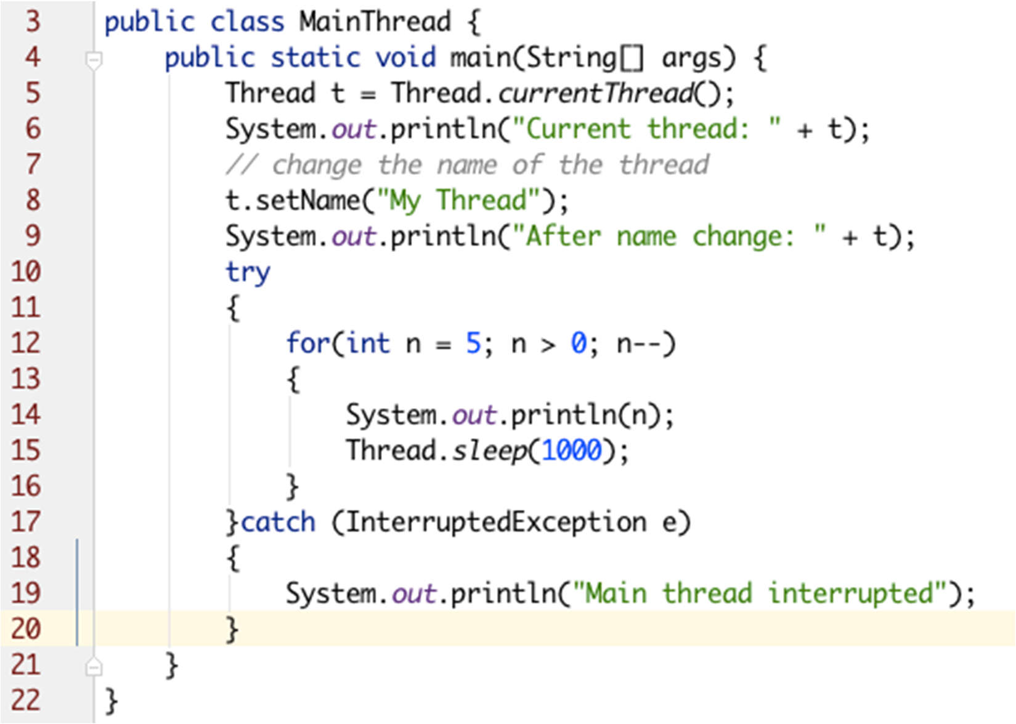
Main Thread

Slide 6
How to create Thread
By extending the Thread class
By implementing Runnable Interface
Extending Thread
Need to override the public void run() method
Implementing Runnable
Need to implement the public void run() method

Slide 7
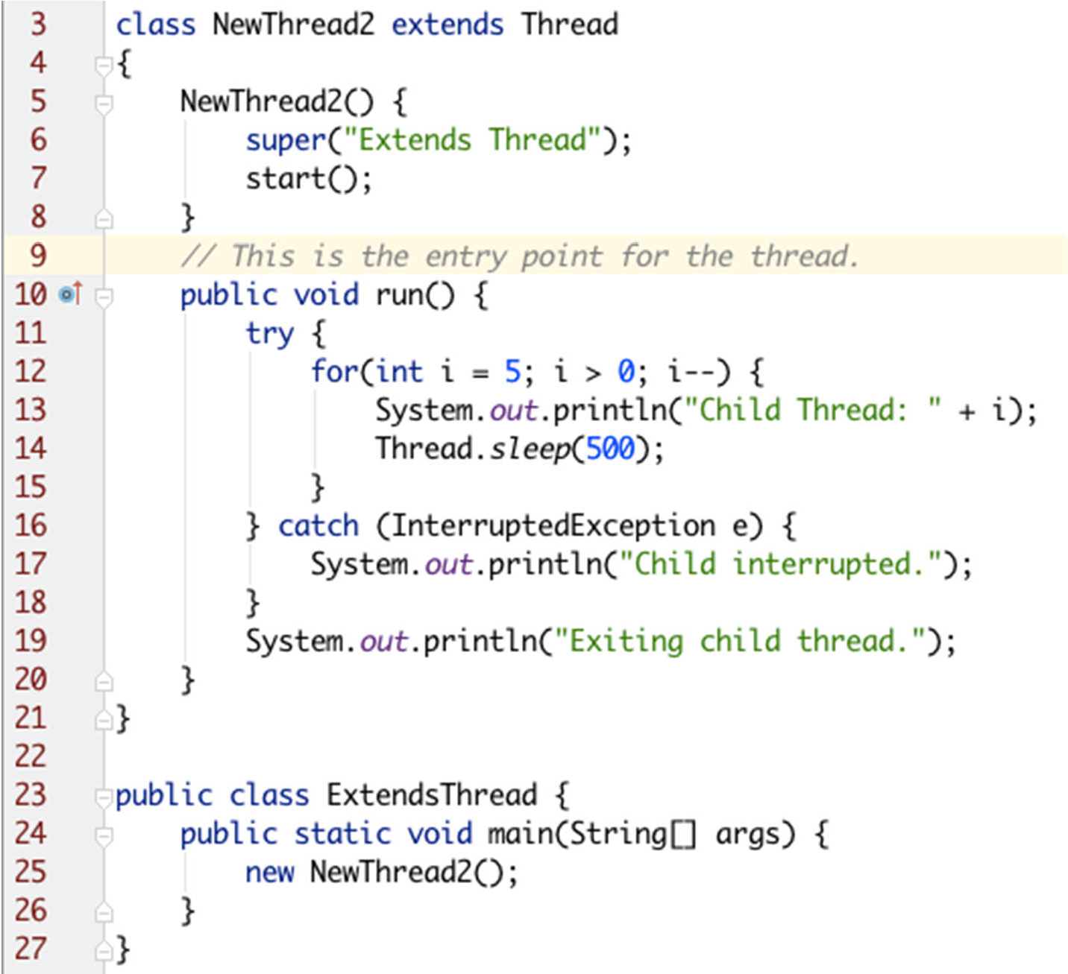
Extending Thread

Slide 8
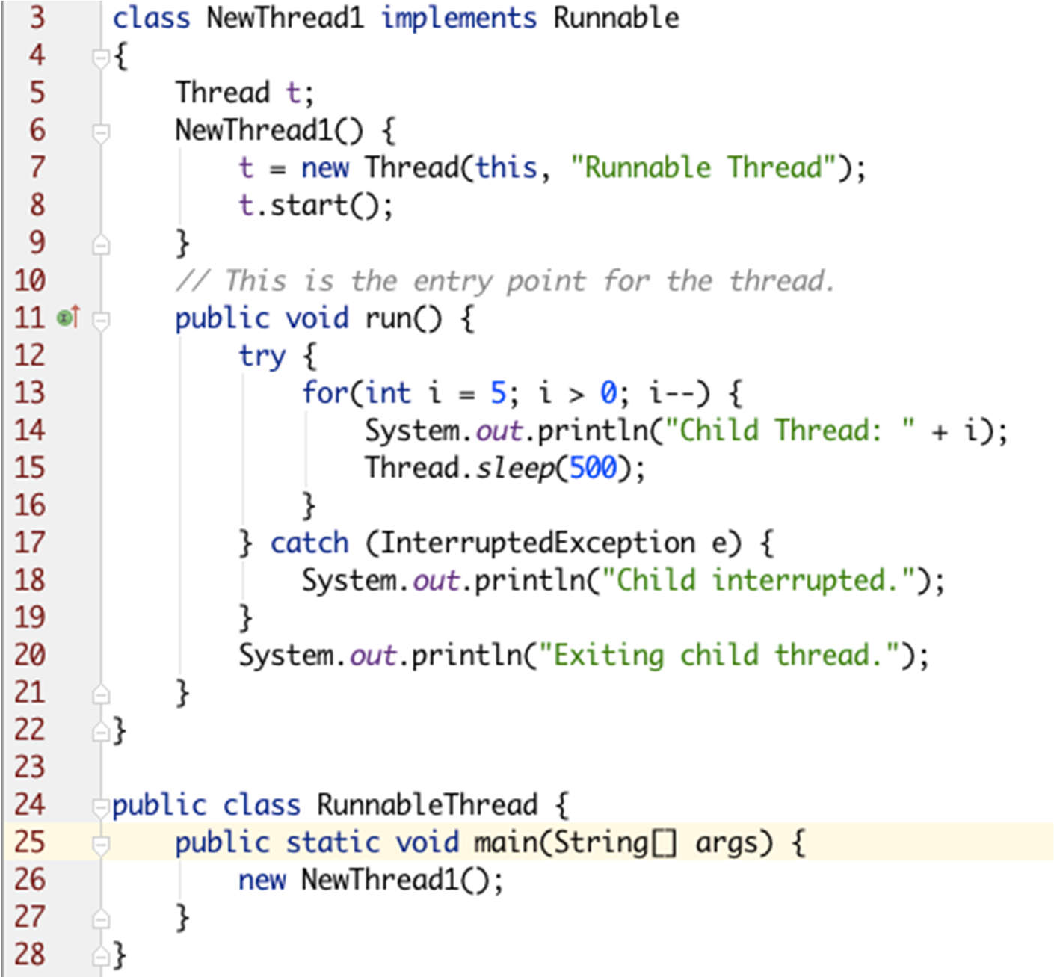
Implementing Runnable

Slide 9
Join Method of Thread
The join() method allows one thread to wait for the completion of another thread, ensuring that the current thread doesn't proceed until the specified thread finishes execution.
Practical Use: It's useful when you need one task to finish before starting another, such as when thread dependencies exist in a multithreaded program.
Example: Summation.java

Slide 10
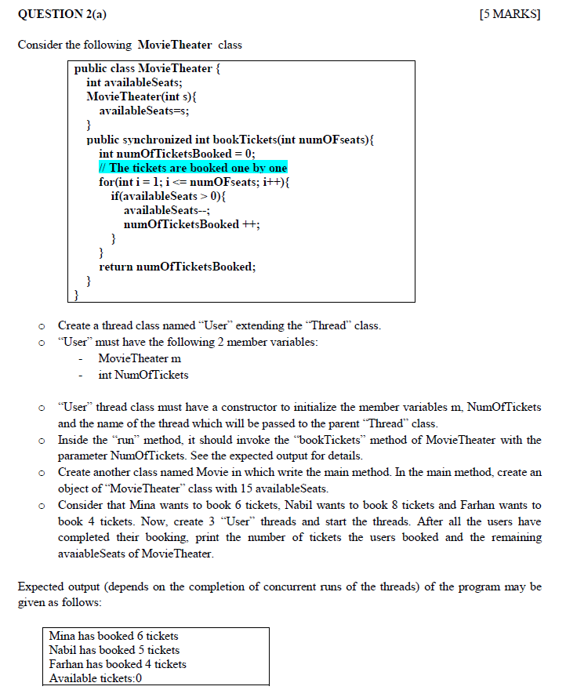
Spring 2024 Question 2(a)

Slide 11
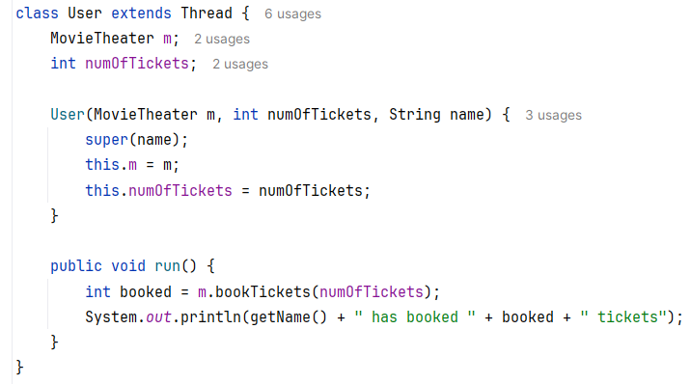
Spring 2024 Question 2(a)

Slide 12
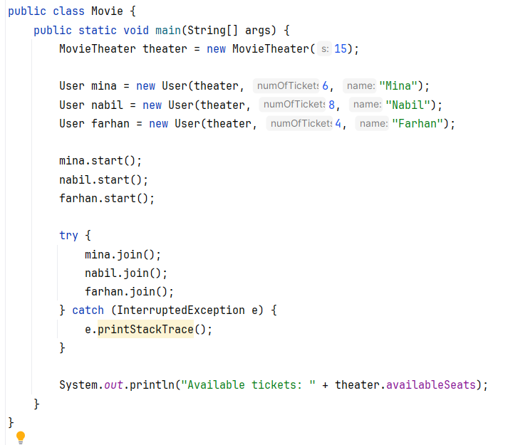
Spring 2024 Question 2(a)

Slide 13
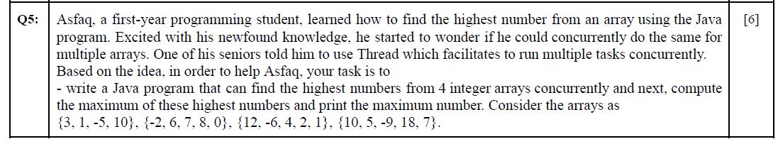
Fall 2023 Question 5

Slide 14
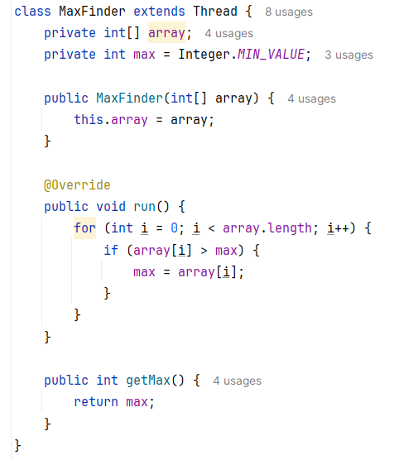
Fall 2023 Question 5

Slide 15
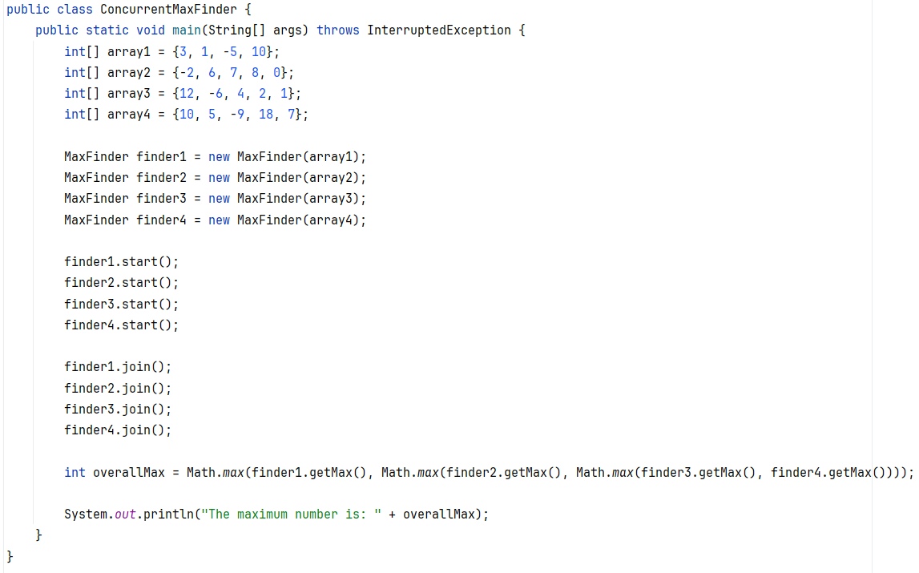
Fall 2023 Question 5

Slide 16
Thank You

